Slide 1
A-16 webinar Using MyLION To Promote and Report Club Service Activities
Presenter: PCC Tim Cheung
Moderator: Lion Veronica (Ronnie) Wickens
Lion Megan Bennett
February 16, 2021

Slide 2
Some notes to observe:
This webinar will be recorded
Please mute yourself when not speaking
You can ask questions, or share comments during the session via the “chat box”
You can “Raise Your Hand” for your turn to speak on your questions or comments
You will be asked to respond to polls. (Poll #1)

Slide 3
Welcome remarks - DG Glenn Conduit

Slide 4
Agenda
How to sign-in to MyLION
Using MyLION to:
Create/Promote Future Service Activities
Report Past Activities
Metrics – what can you see
Other Lions apps available – Learn, Shop, and MyLCI (optional - if we have time)

Slide 5
Session objectives:
To demonstrate the processes in
creating/promoting/reporting Club service
activities with MyLION;
To show the information available in MyLION Metrics and the importance of it;
To enable you as Club Officers to use MyLION to plan/promote/report Club service activities

Slide 6
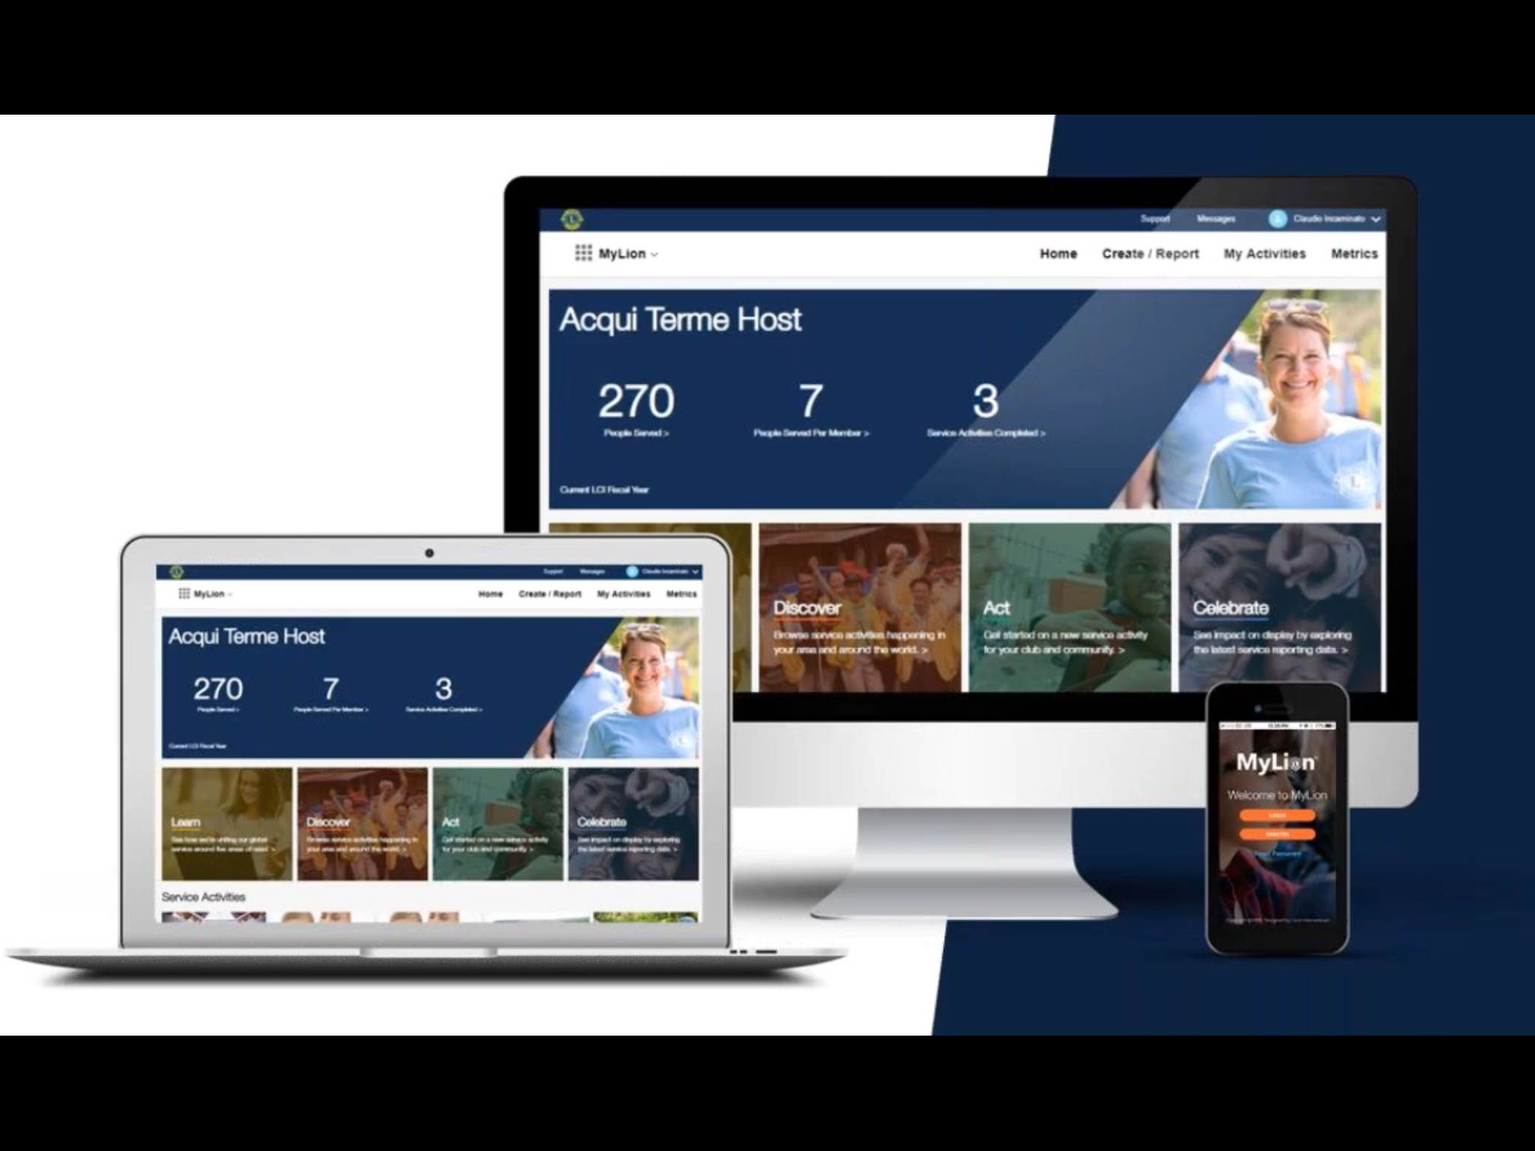
What is MyLION?
Available in multiple platforms
(PC, tablet, & cellphone)
MyLION is the tool for Lions Clubs worldwide to
PLAN, INVITE, and SHARE service activities
REPORT service activities
FIND, CONNECT, and CHAT with Lions and Leos from all over the world
VIEW key service data for your Club, District, Multiple District, and International.

Slide 7
Have you used MyLION before ? (Let’s launch poll #2)

Slide 8
It all starts with :
The LCI website: lionsclubs.org
Click: Member Login
Let’s go to the various sign-in screens with:
a tablet
an iPAD
a laptop

Slide 9
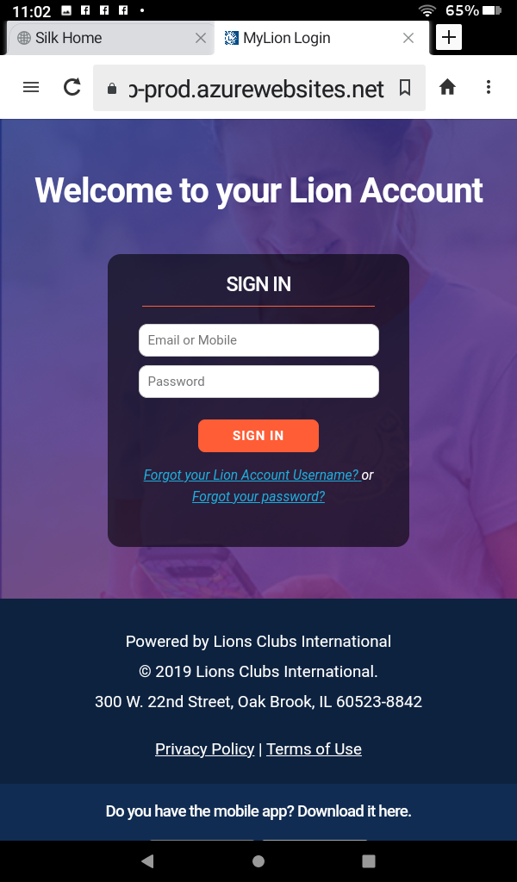
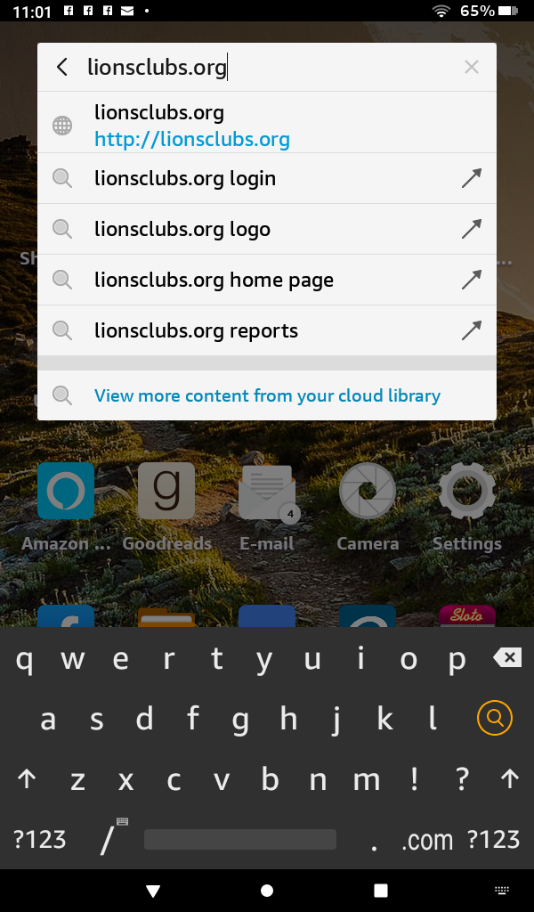
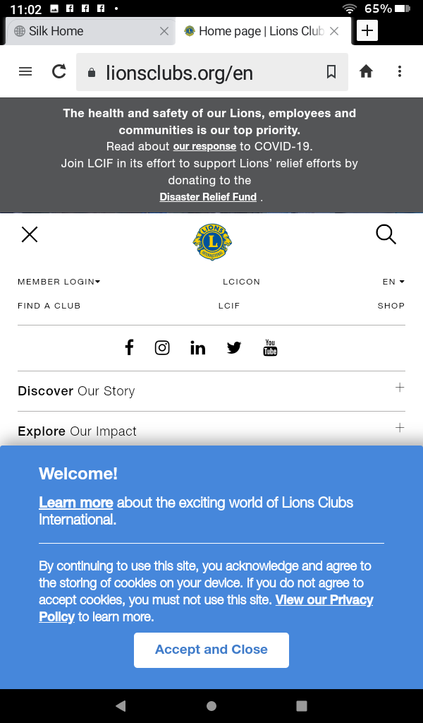
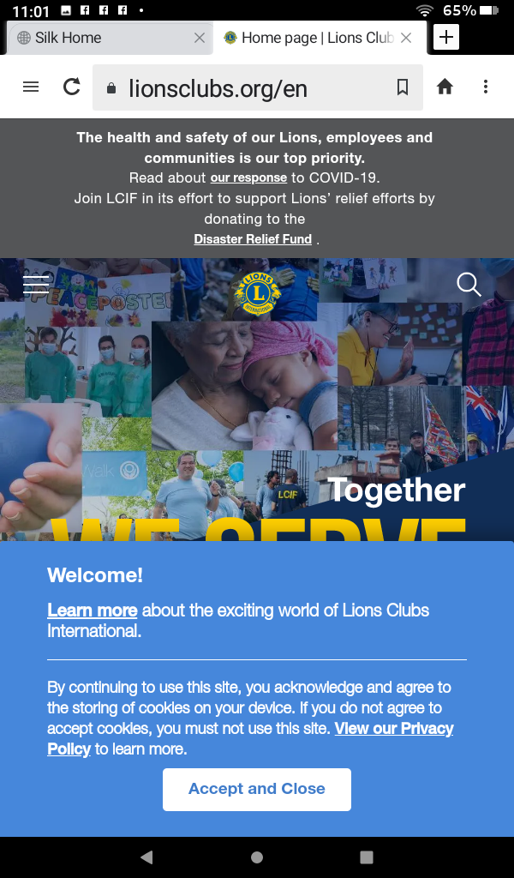
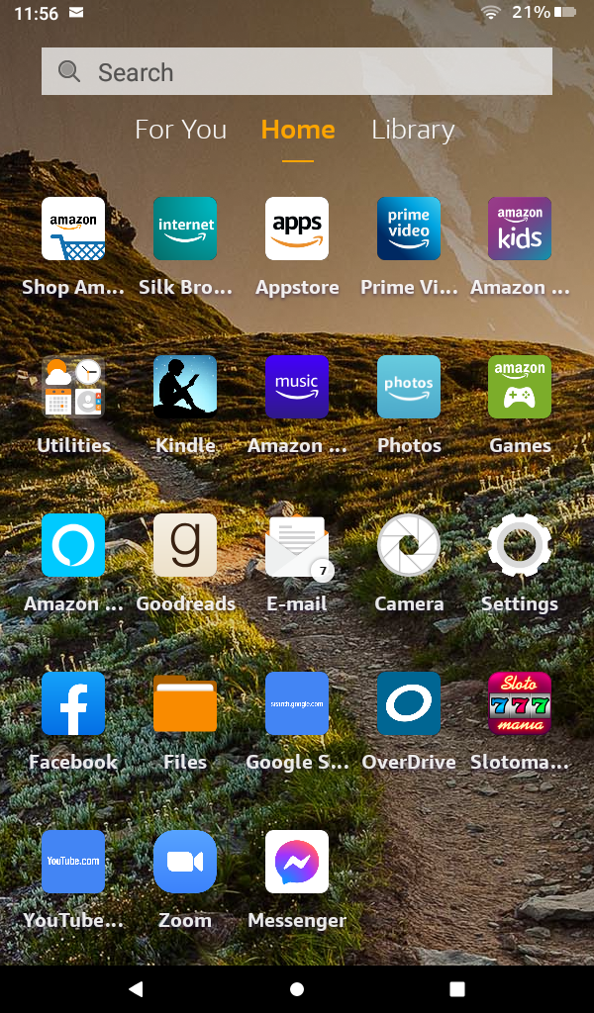
Sign-in
Screens
using
a tablet

Slide 10
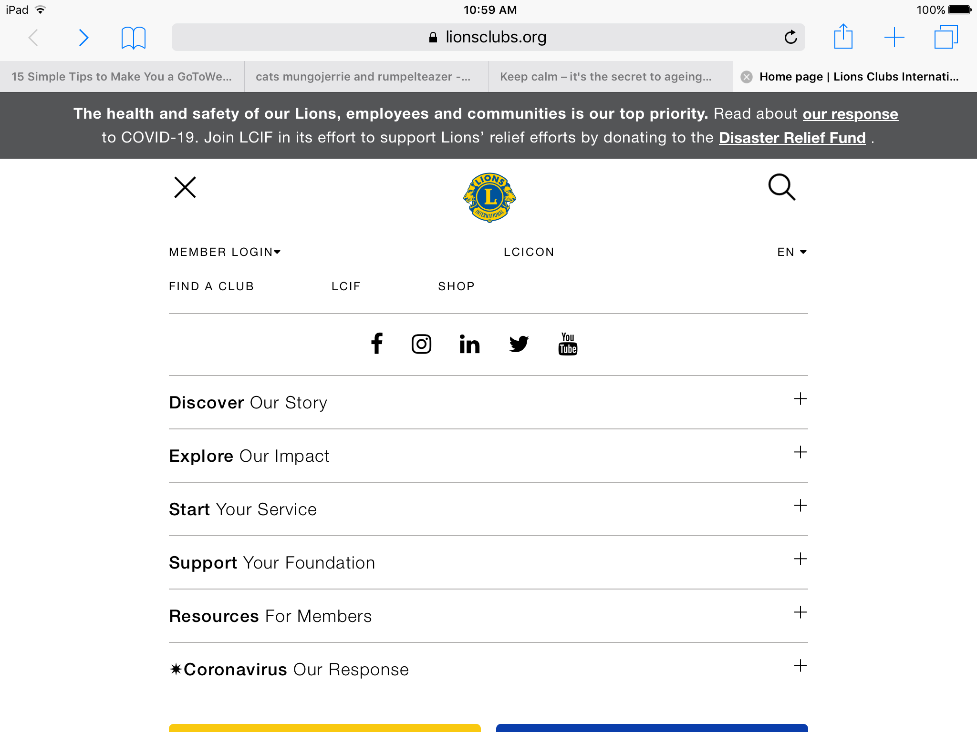
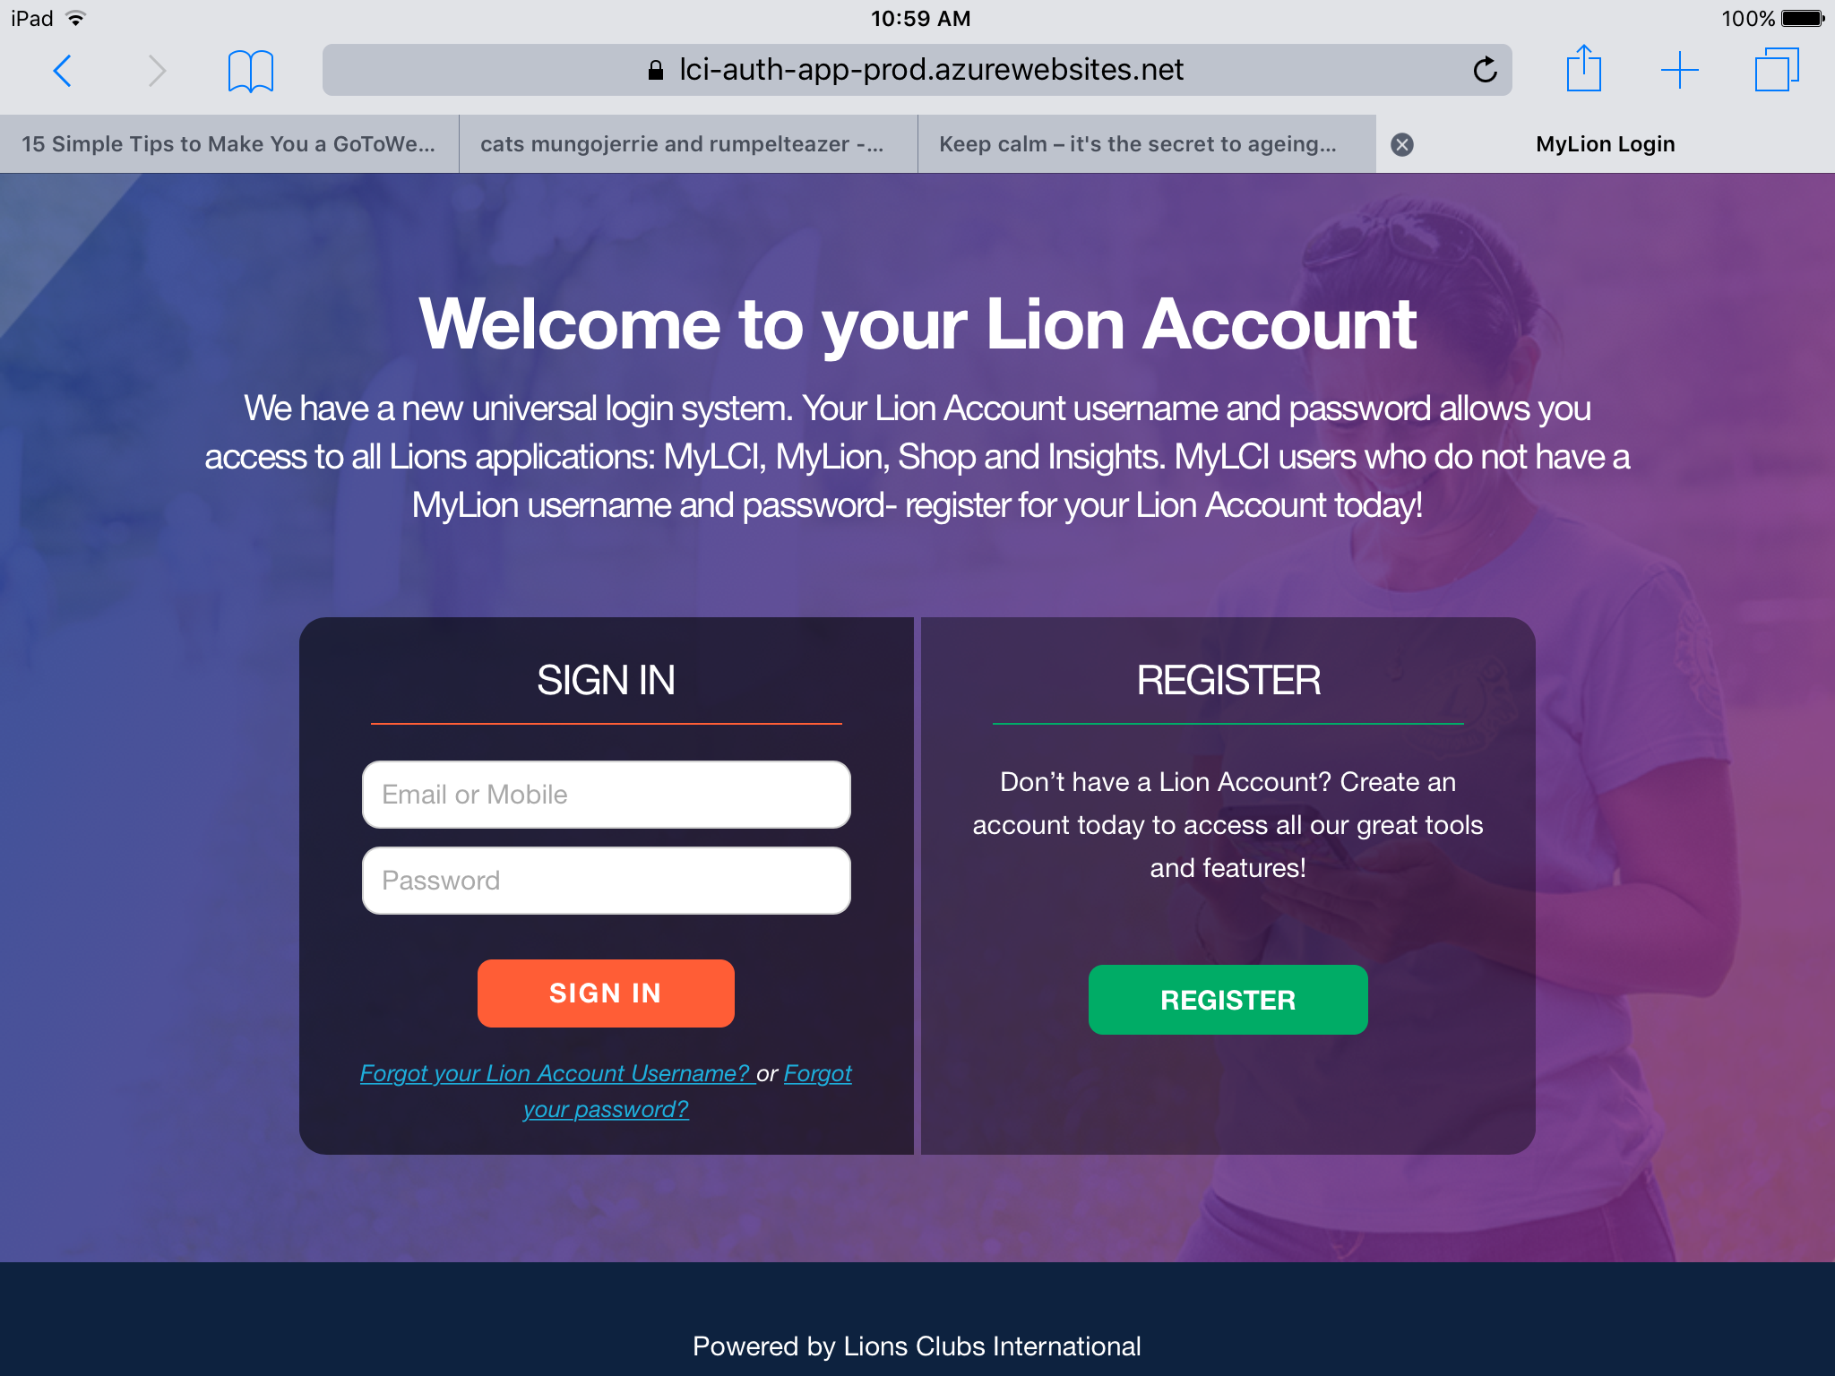
Sign-in
Screens
Using
An iPad

Slide 11
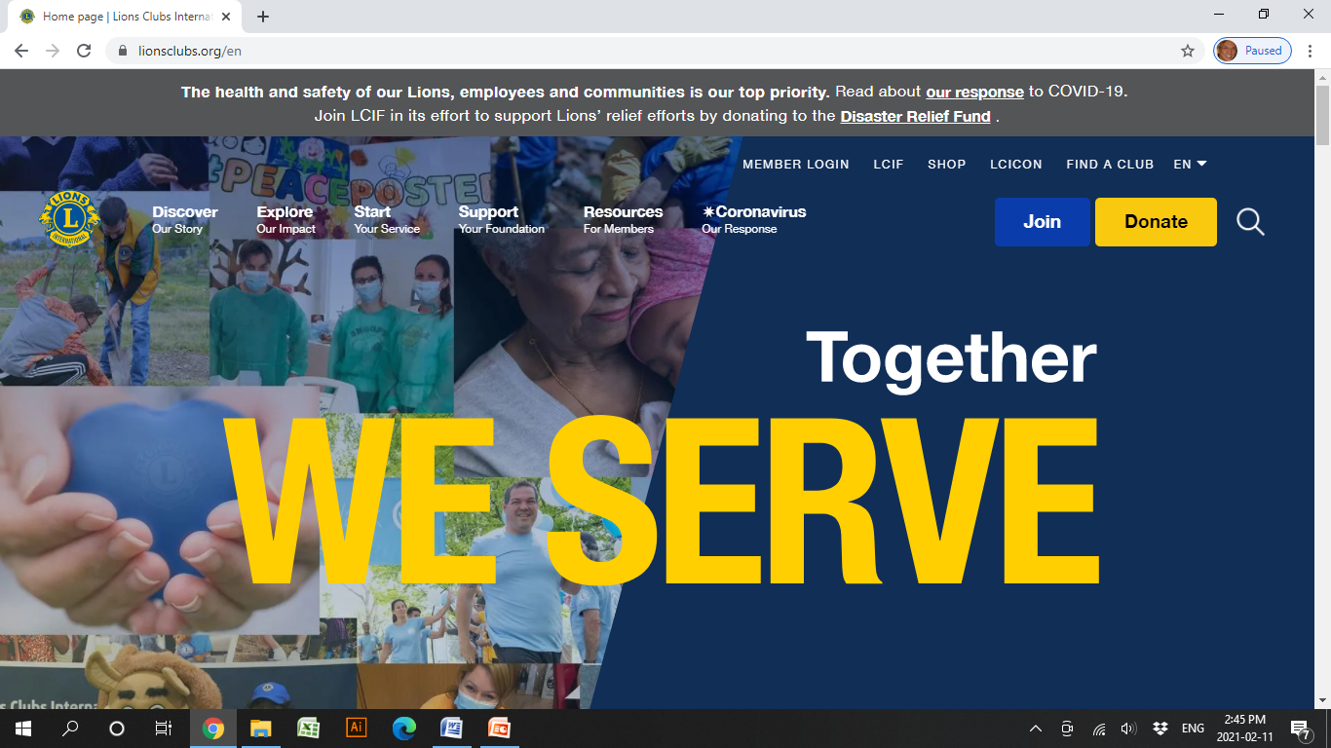
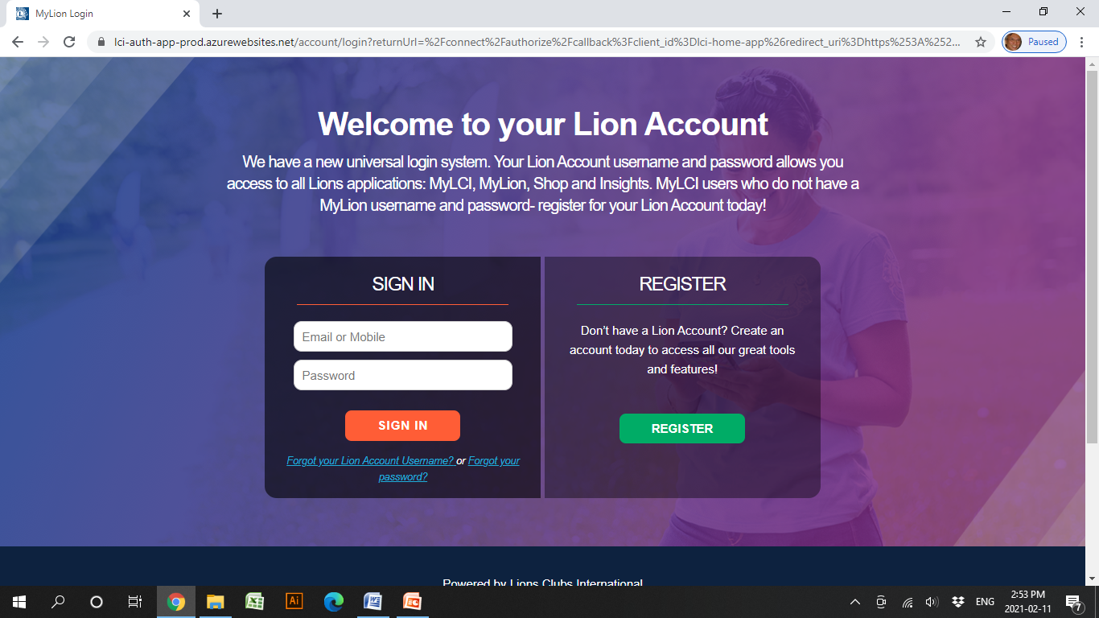
Sign-in Screens Using a Laptop

Slide 13
Let’s go to a live demonstration on:
Creating a future service activity
Reporting a past service activity
What can you see in the Metrics

Slide 14
Live Demo

Slide 15
Introducing the A-16 MyLION support team:
Lion Veronica Wickens of Omemee
Email: vjwickens@gmail.com
Lion Megan Bennett of Newmarket
Email: mbennett@lionsa16.com
Lion Tim Cheung of Angus Glen
Email: tcheung@lionsa16.com

Slide 16
Other Lions Apps available

Slide 17
Questions / Comments

Slide 18
Session objectives:
To demonstrate the processes in
creating/promoting/reporting Club service activities with MyLION;
To show the information available in MyLION Metrics and the importance of it;
To enable you as Club Officers to use MyLION to plan/promote/report Club service activities

Slide 19
Poll # 3

Slide 20
Thank You !

